Slide 1
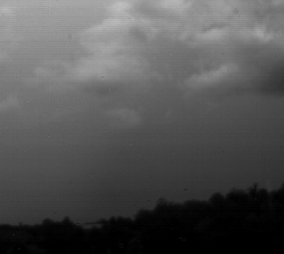
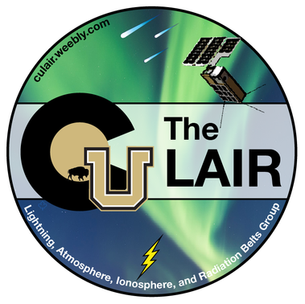
Lightning: Energetic Connections between Earth and Space
Catherine Xiao, A. Wold, A. Shane, R. Marshall, R. Reid, G. Berland, A. Sousa
SPUR Presentation
Dr. Marcelo Saba, National Institute for Space Research, Brazil
Notes:
Introduce self

Slide 2
Science Background

Slide 3
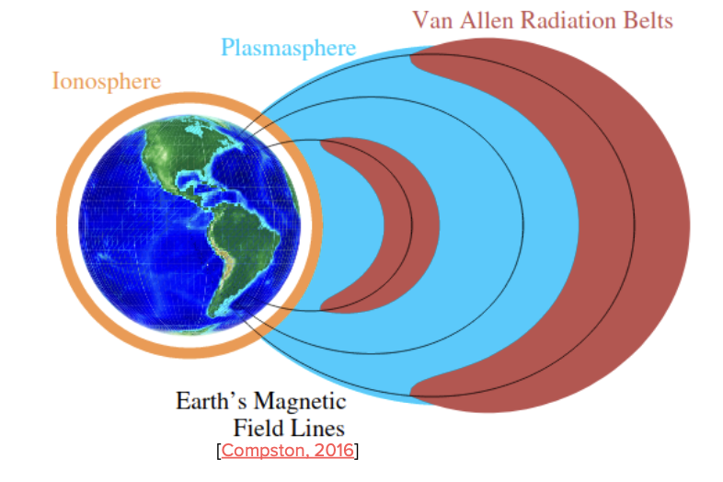
Background: Space Environment
Ionosphere - ionized region of the Earth’s atmosphere
Magnetosphere - region dominated by Earth’s magnetic field
Van Allen Radiation Belts - toroidal regions of highly energetic charged particles around the Earth
Plasmasphere - inner magnetosphere, the region of the Earth's magnetosphere consisting of low-energy (cool) plasma
These regions are where the lightning generated whistler

Slide 4
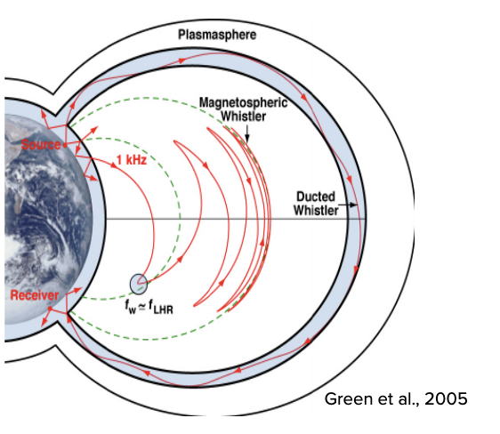
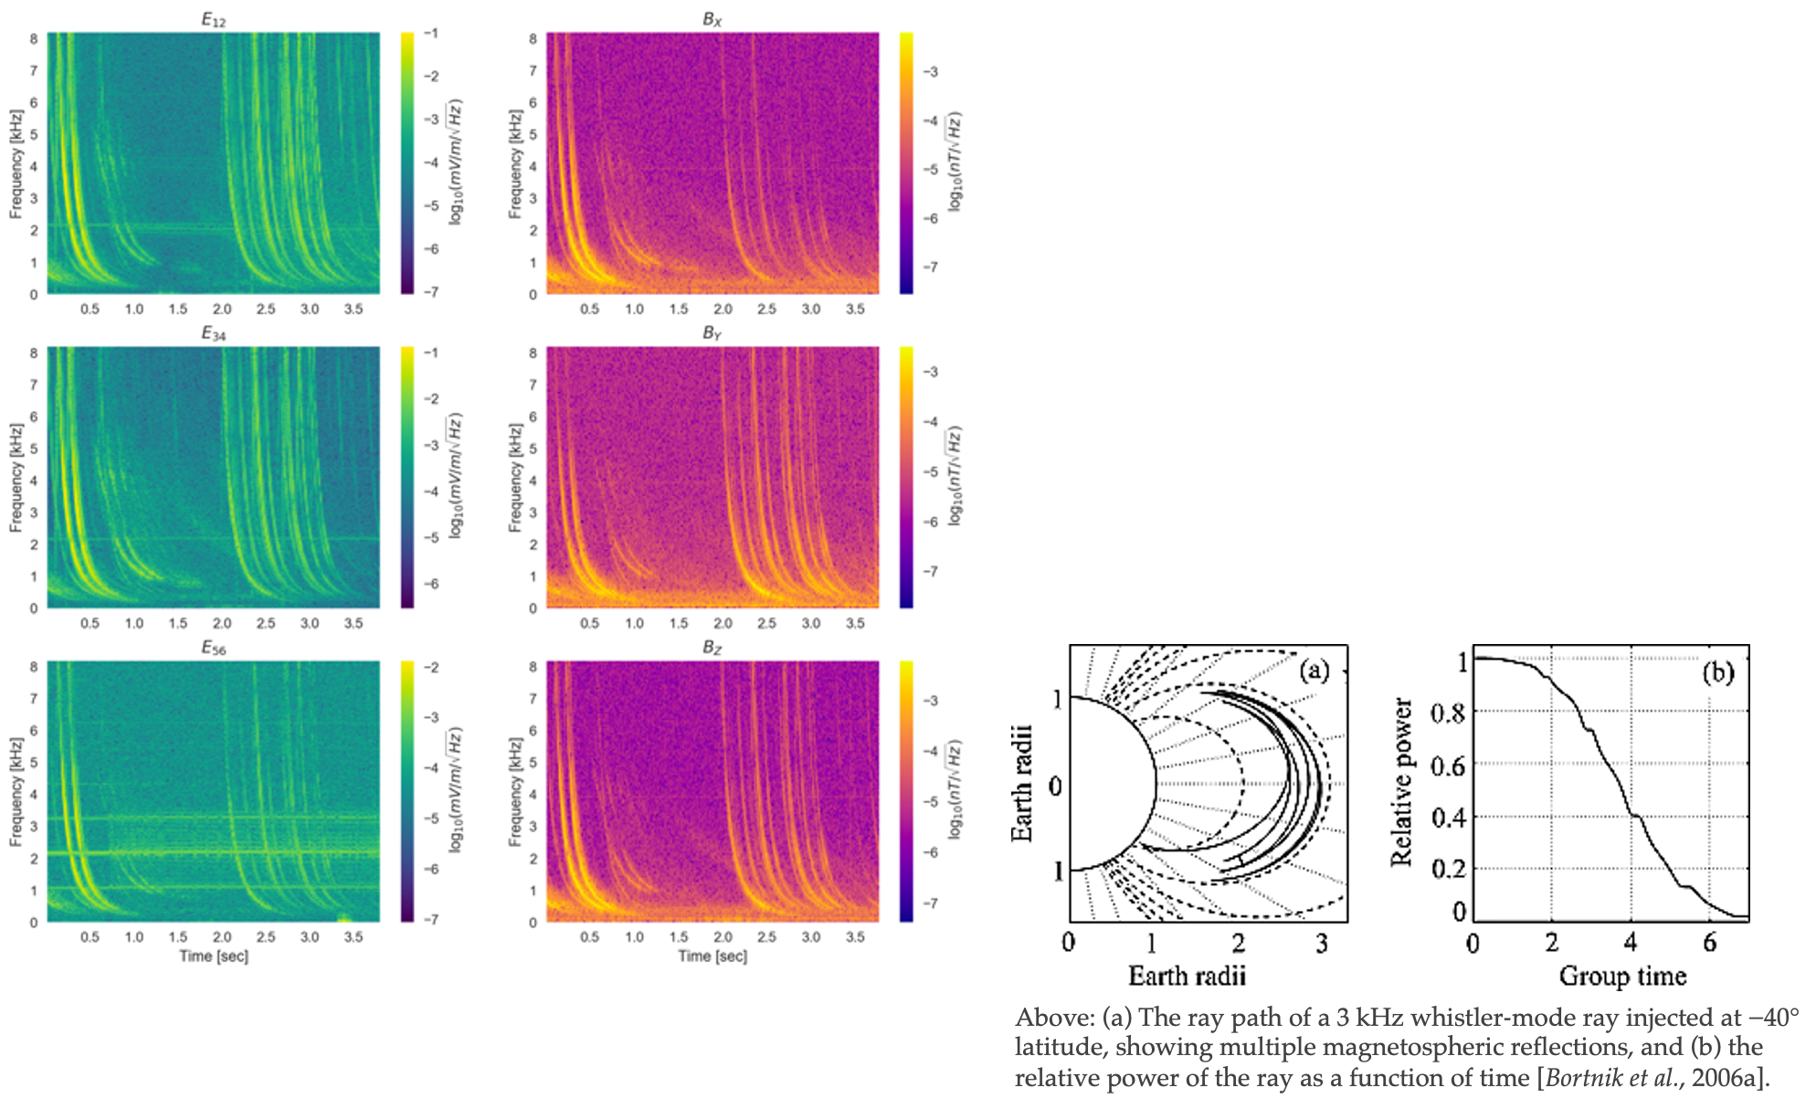
Background: Lightning Generated Whistlers
Lightning Generated Whistlers - very low frequency (VLF) electromagnetic waves (~<30 kHz)
Lightning-induced electron precipitation (LEP) as a loss mechanism for radiation belt electrons
This has significant impacts on Earth’s atmosphere

Slide 5
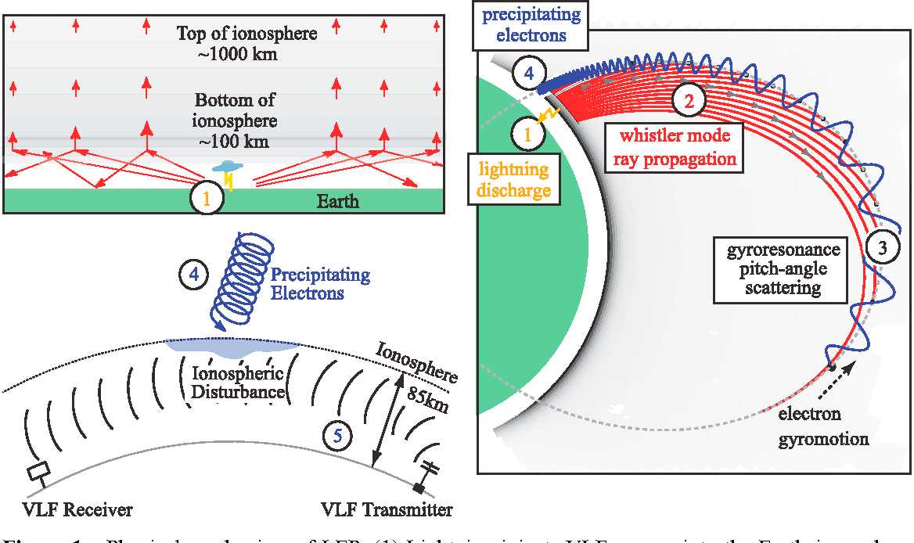
Science Goal
Goal: Investigating energy transfer from earth to space through lightning to better understand how well the model calculations work mainly through analysis of ground-based lightning detection data, spacecraft LGW measurements, and ray tracing analysis
Importance of investigating lightning:
Electron precipitation caused by LGWs can lead to the destruction of the ozone layer, exposure to more radiation in certain regions
Peter, 2007
Notes:
Explain figures : 1,2,3,4

Slide 6
SPUR objectives
Investigate spatial dist of lightning
Investigate seasonal dist of lightning
Comparison to spacecraft data
Ray tracing

Slide 7
Data collection

Slide 8
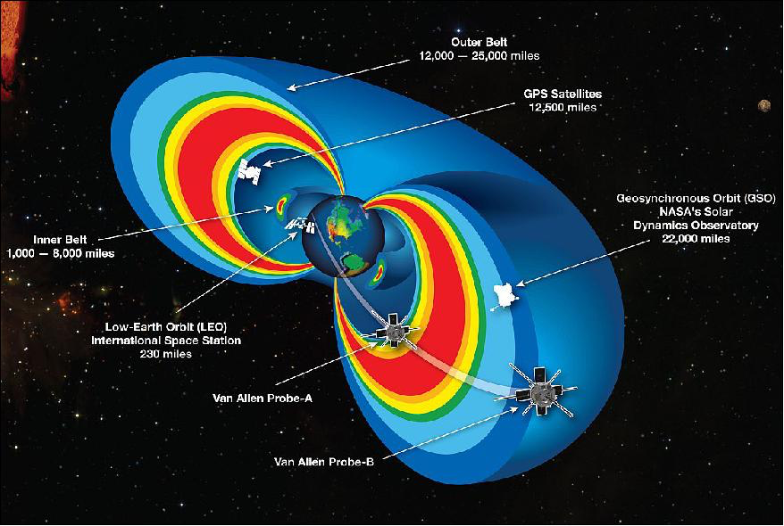
Data
Van Allen Probes
Van Allen probes mission lasted from 2012 to 2019
Consisted of two spacecraft in highly elliptical orbits (~600 km x ~30000 km)
Burst mode wave data (automatic trigger collects 4 seconds of high resolution data)
Previous work identified the bursts that contained lightning generated whistlers signals
GLD360
Long-range network that employs both Time-Of-Arrival (TOA) and Magnetic Direction Finding (MDF) techniques
Provides real time data and detects thunderstorms anywhere around the world
Detects both in-cloud and cloud-to-ground lightning
Data includes peak current, longitude, and latitude

Slide 9
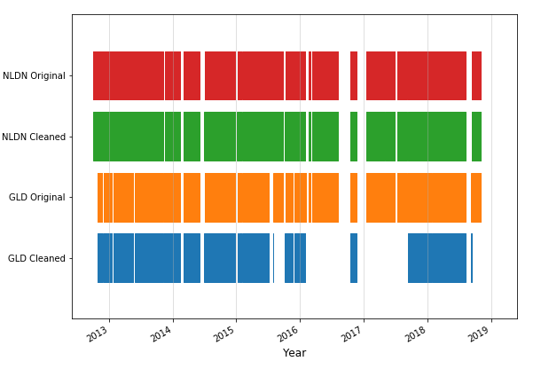
GLD data
A. Sousa
Difference between cleaned vs original GLD data:
Cleaned data
Peak Current [kA]
geographic coordinates
UTC Timestamp
nanoseconds
Original data contained
yr, mo, dy, hy, mn, sc, nanoseconds
Peak current
geographic coordinates
duplicate entries
Austin’s code deleted files containing duplicates, converted data in original to format in cleaned files

Slide 10
Methodology
Combined the peak current, longitude, and latitude for 2015
Visualized data using these libraries: Basemap, Scipy, Matplotlib and NumPy
Split into 4 seasonal plots for the years 2013, 2015, 2018 to compare with the spacecraft data
Difficulties
combining large datasets ( ~20 to 80 GB/year)
missing data (2018 missing ton of Fall data)

Slide 11
Results

Slide 12
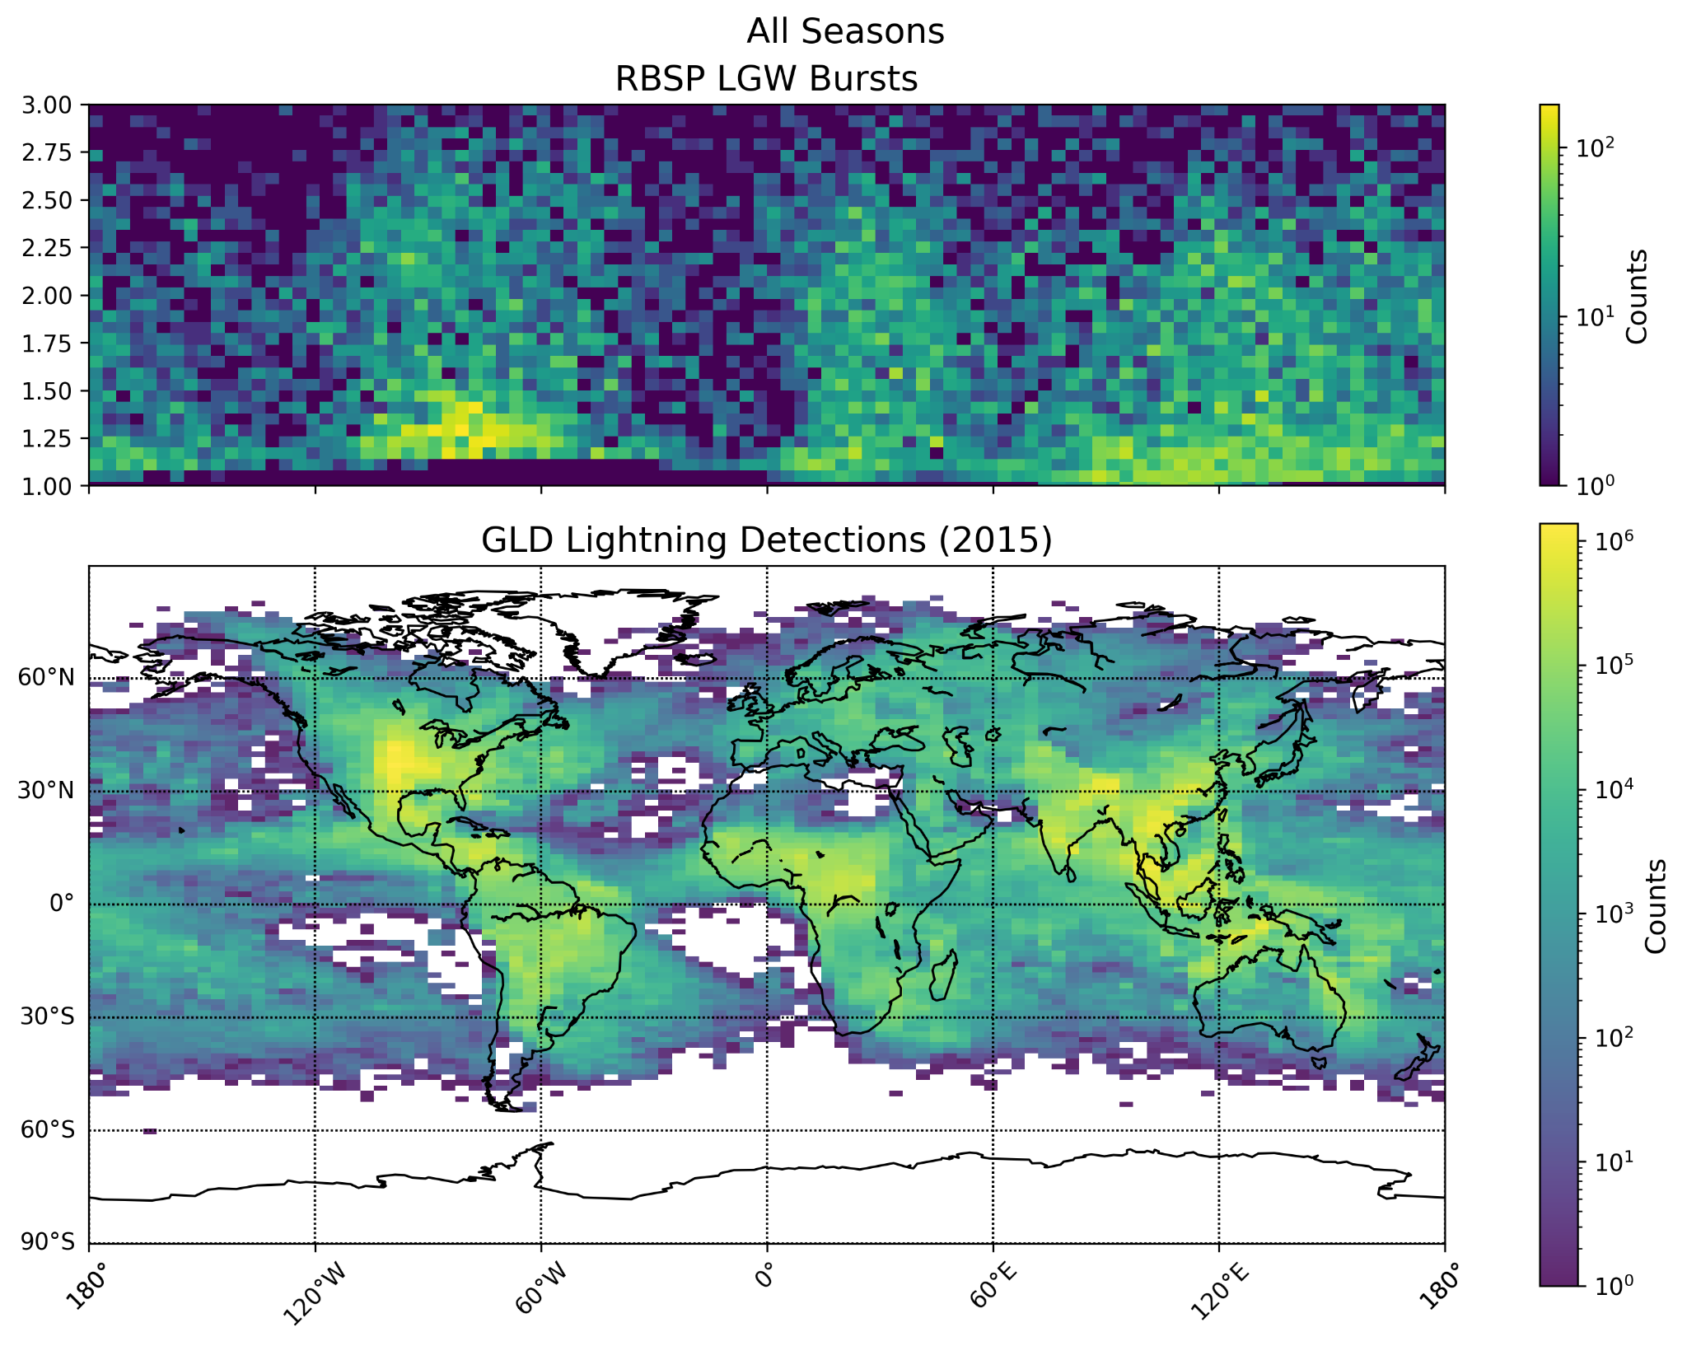
Comparison of space and ground detections (2015)
Latitude
Longitude
Notes:
Describe axis and plots
Color bar is logarithmic
Describe results
Explain spacecraft data (lightning chimneys) and GLD data

Slide 13
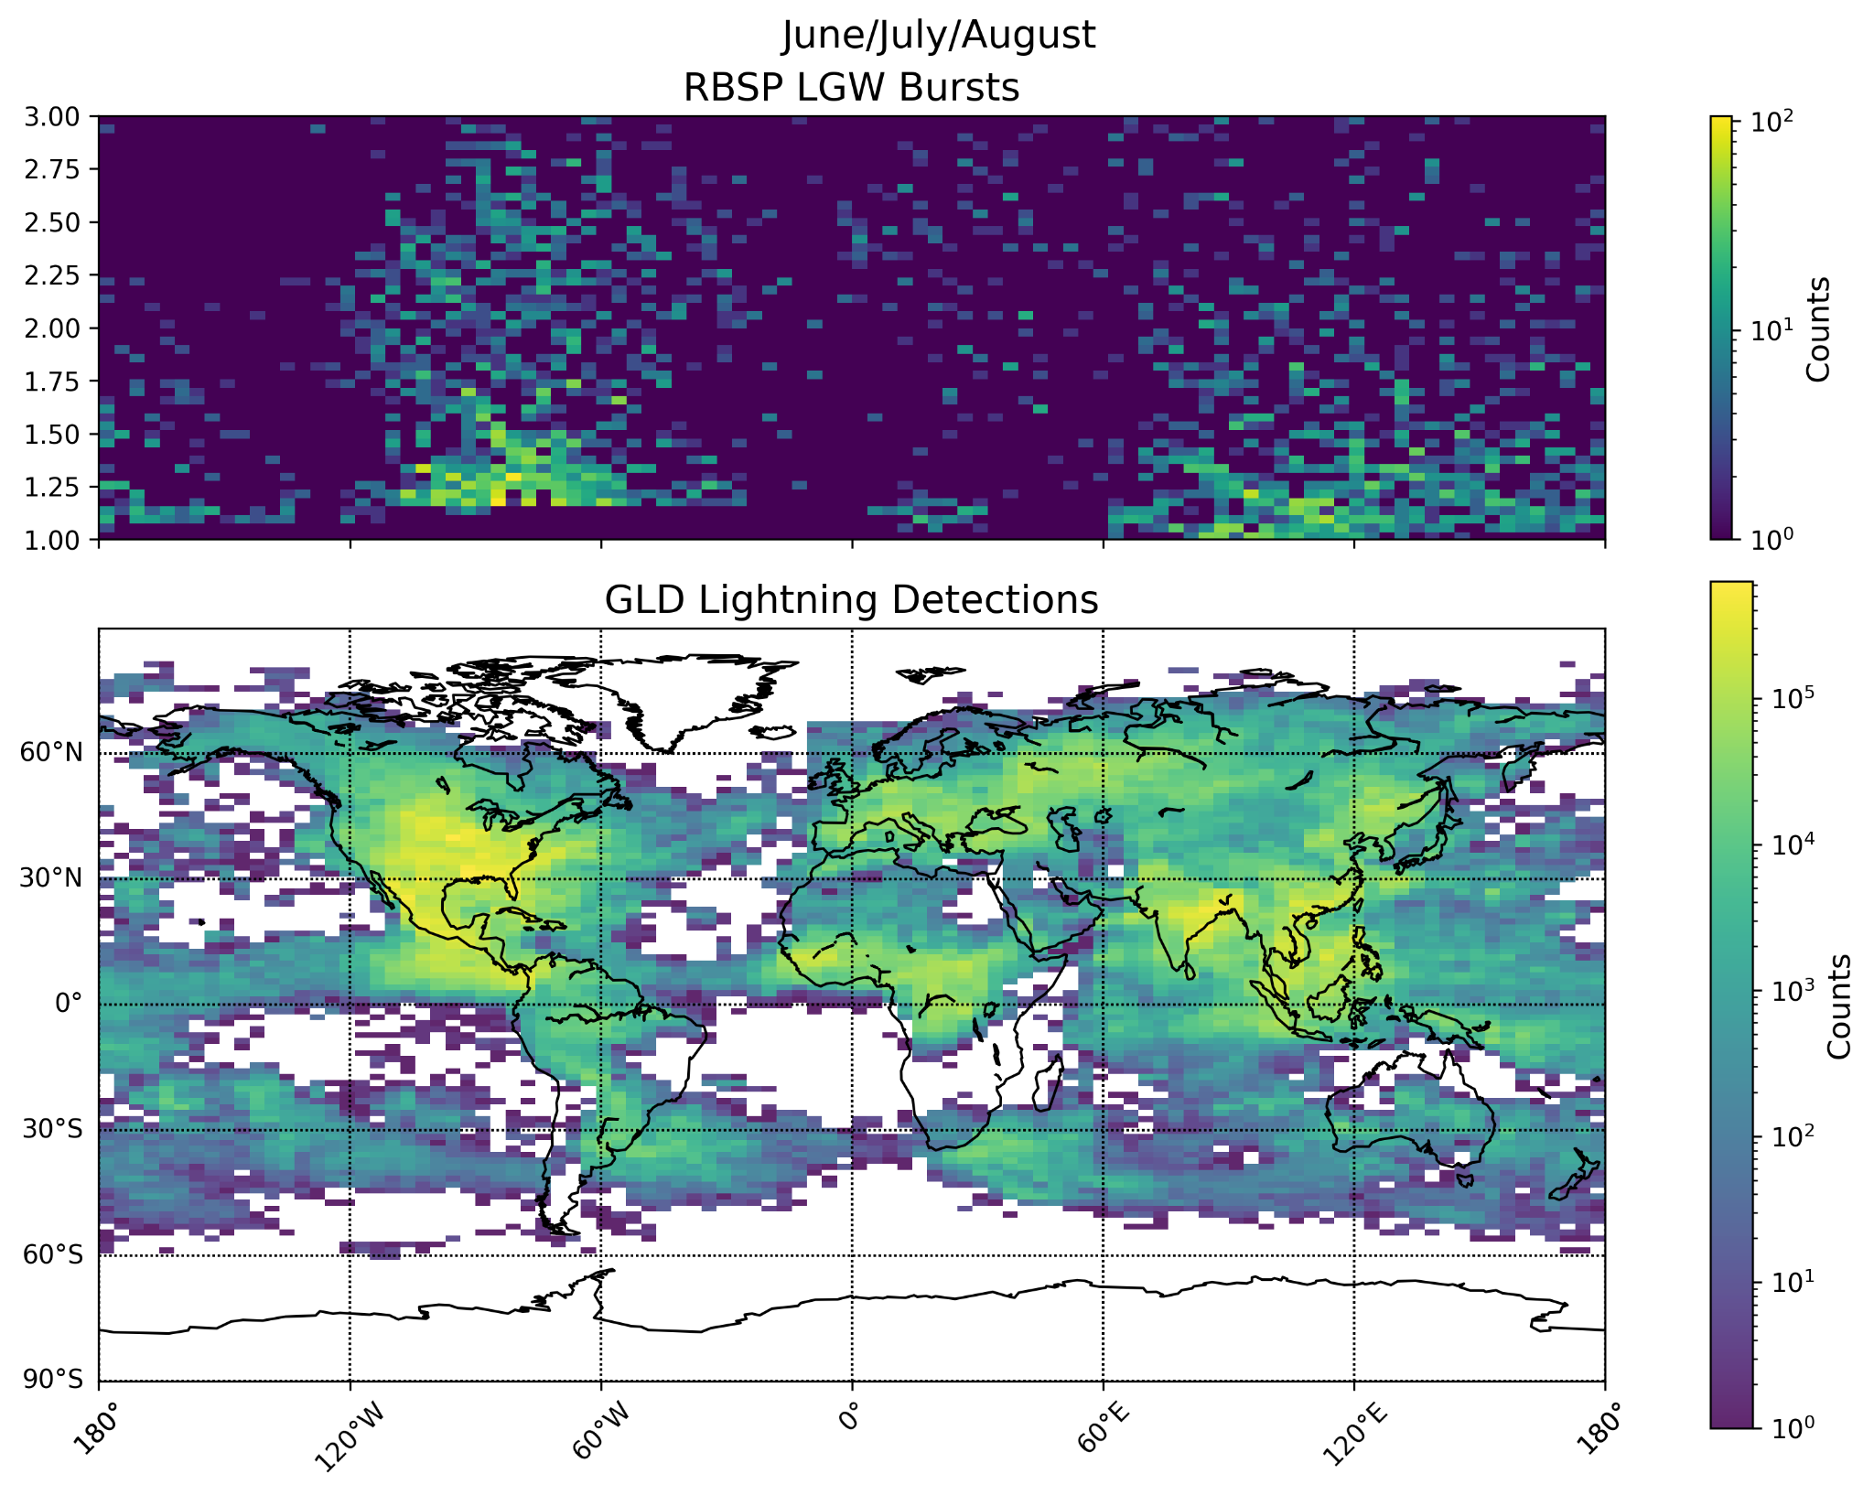
Comparison of spacecraft and ground detection data (Summer 2015)
Latitude
Longitude

Slide 14
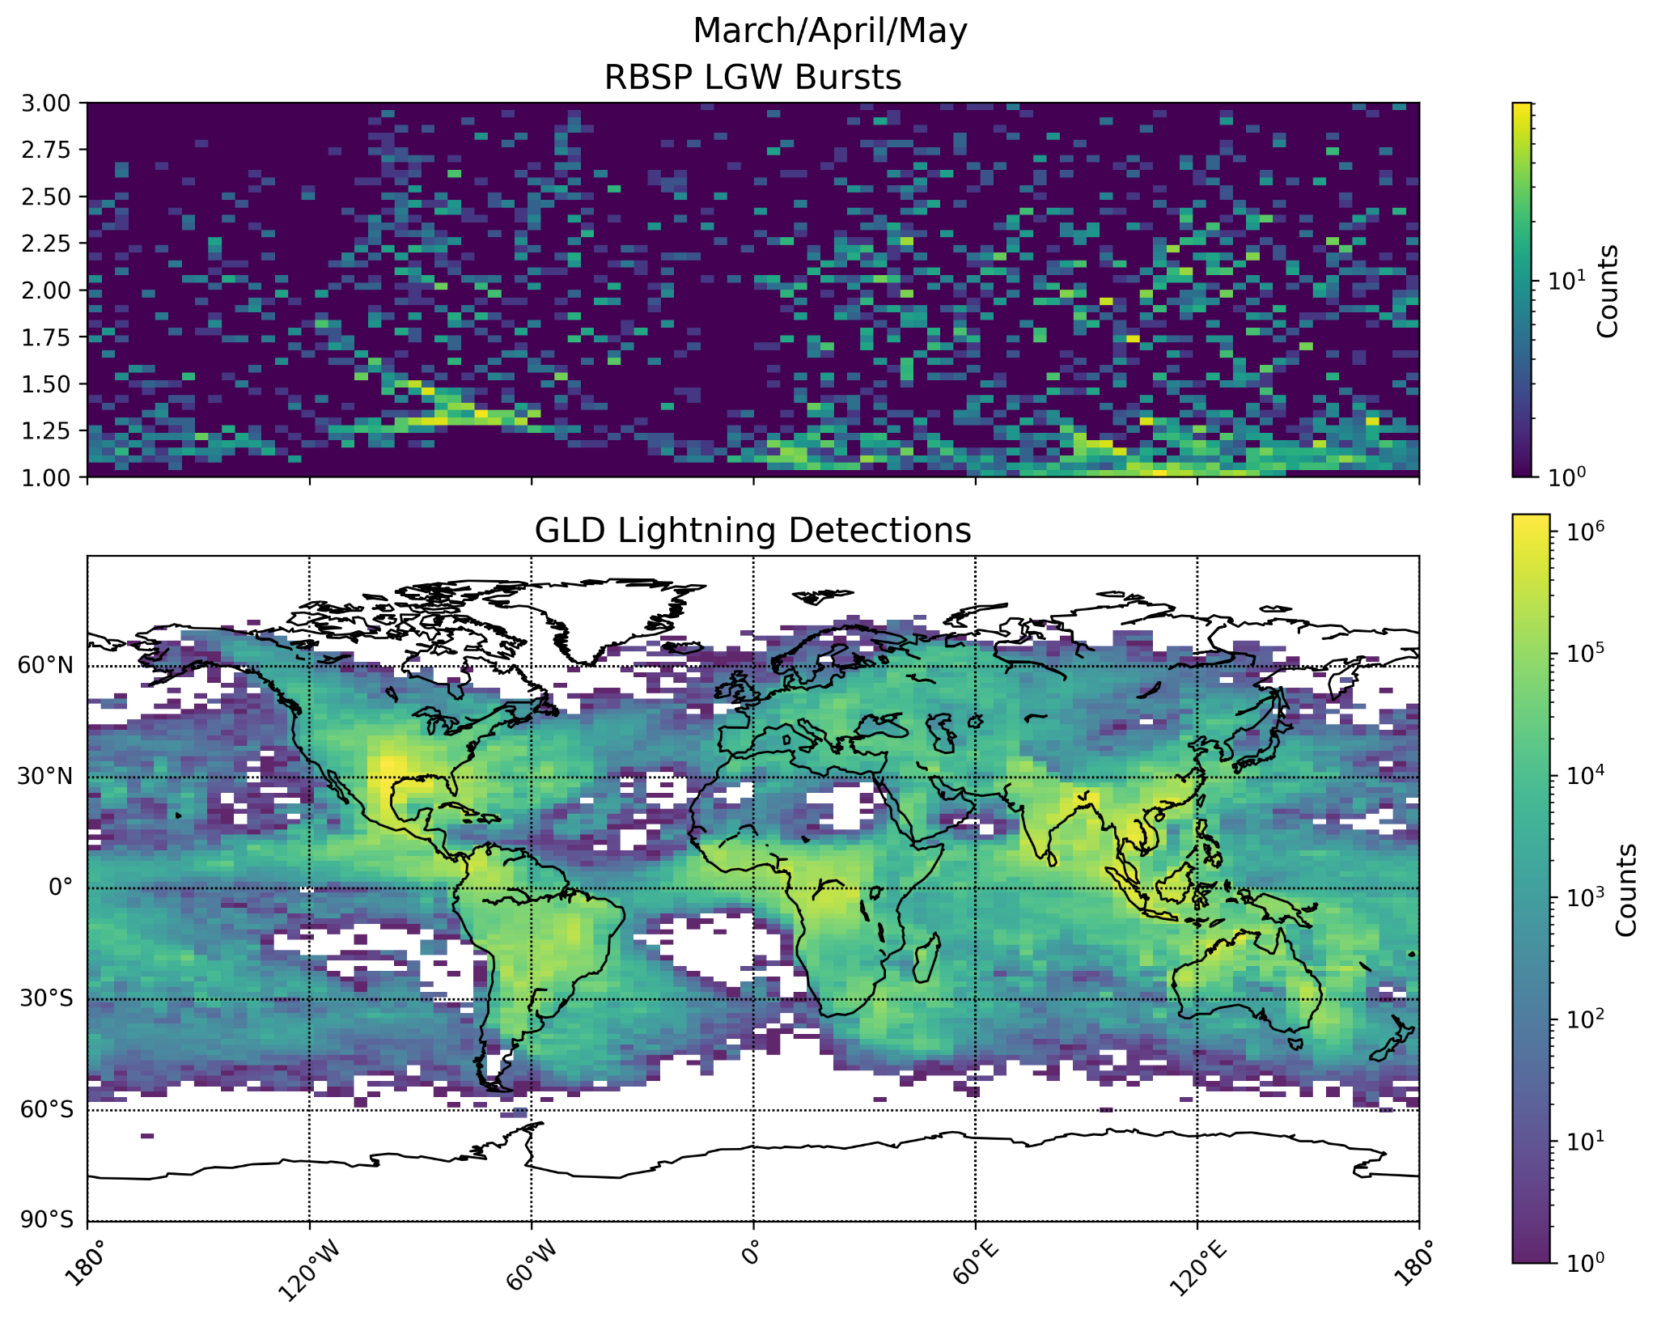
Comparison of spacecraft and ground detection data (Spring 2015)
Latitude
Longitude
Notes:
Plots split into seasons,
Earth radii is the y-axis, spacecraft not orbiting above so first figure doesn’t show as much data in certain region

Slide 15
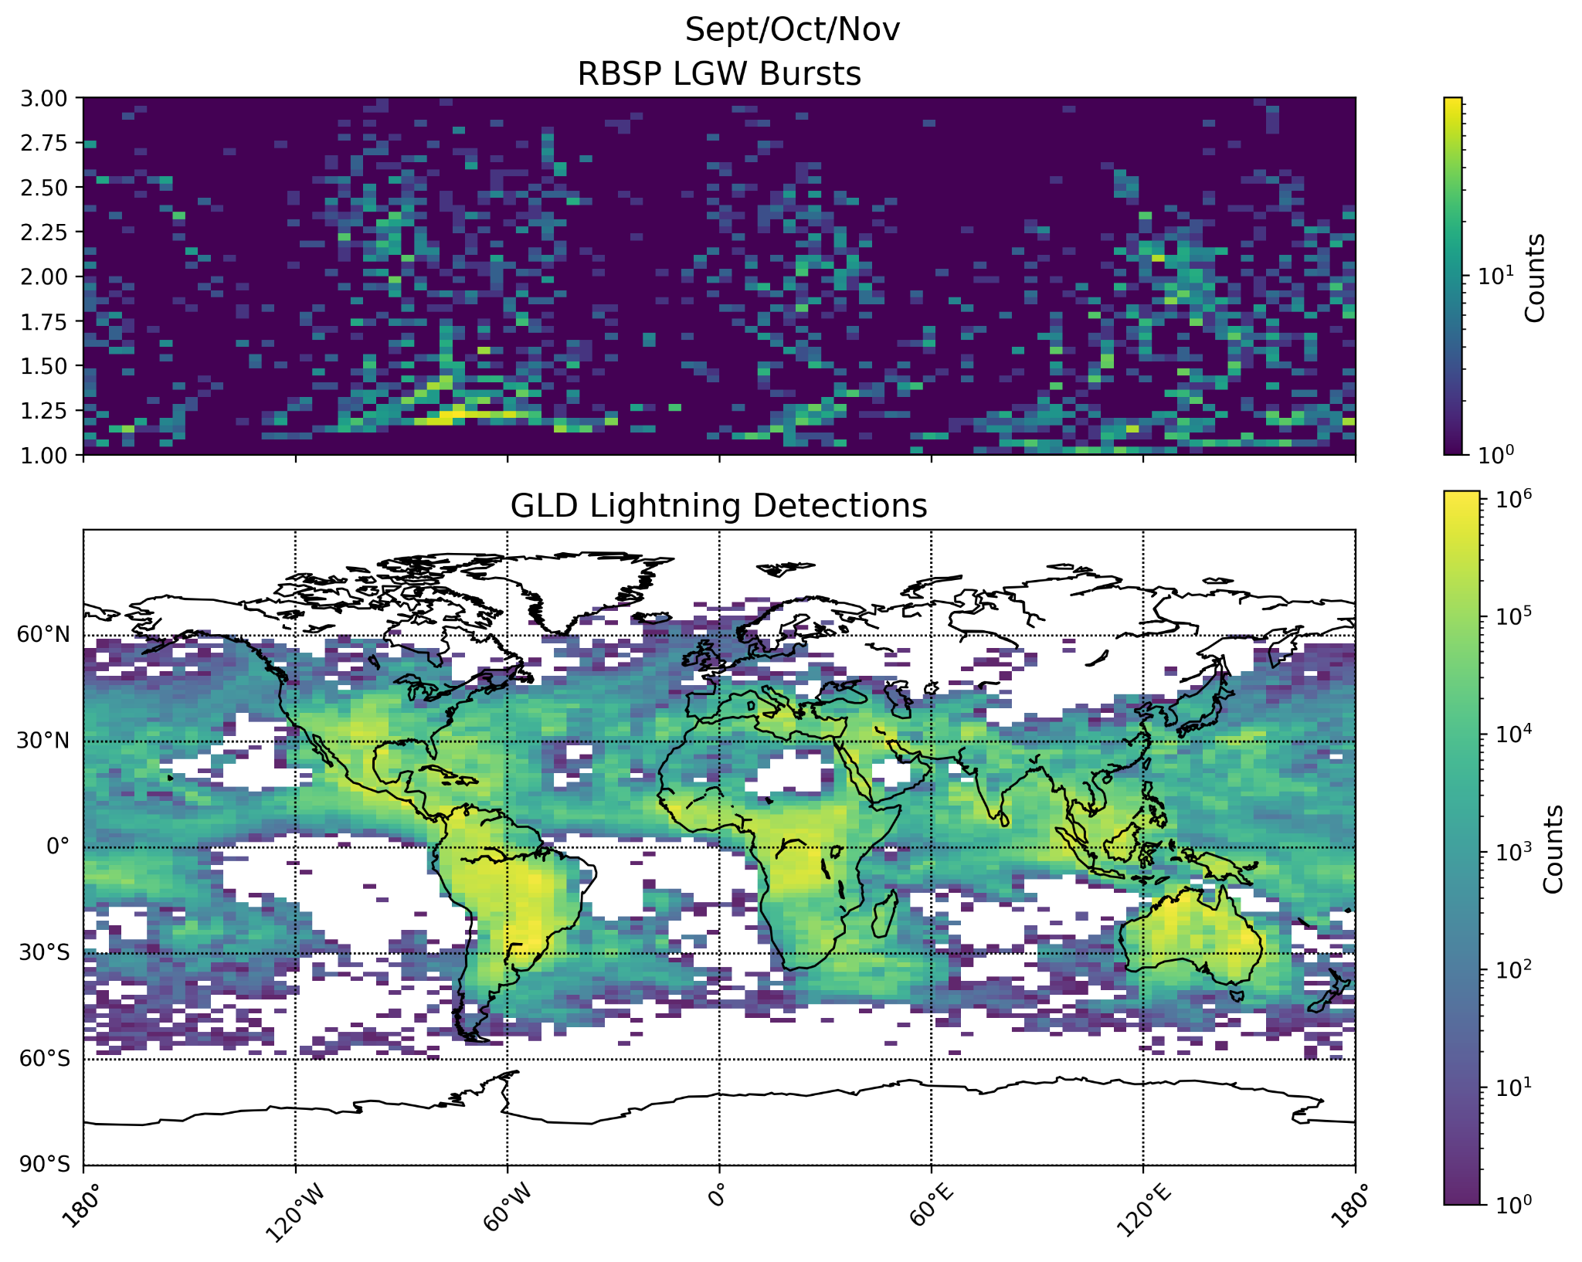
Comparison of spacecraft and ground detection data (Fall 2015)
Latitude
Longitude
Notes:
Plots split into seasons,
Earth radii is the y-axis, spacecraft not orbiting above so first figure doesn’t show as much data in certain region

Slide 16
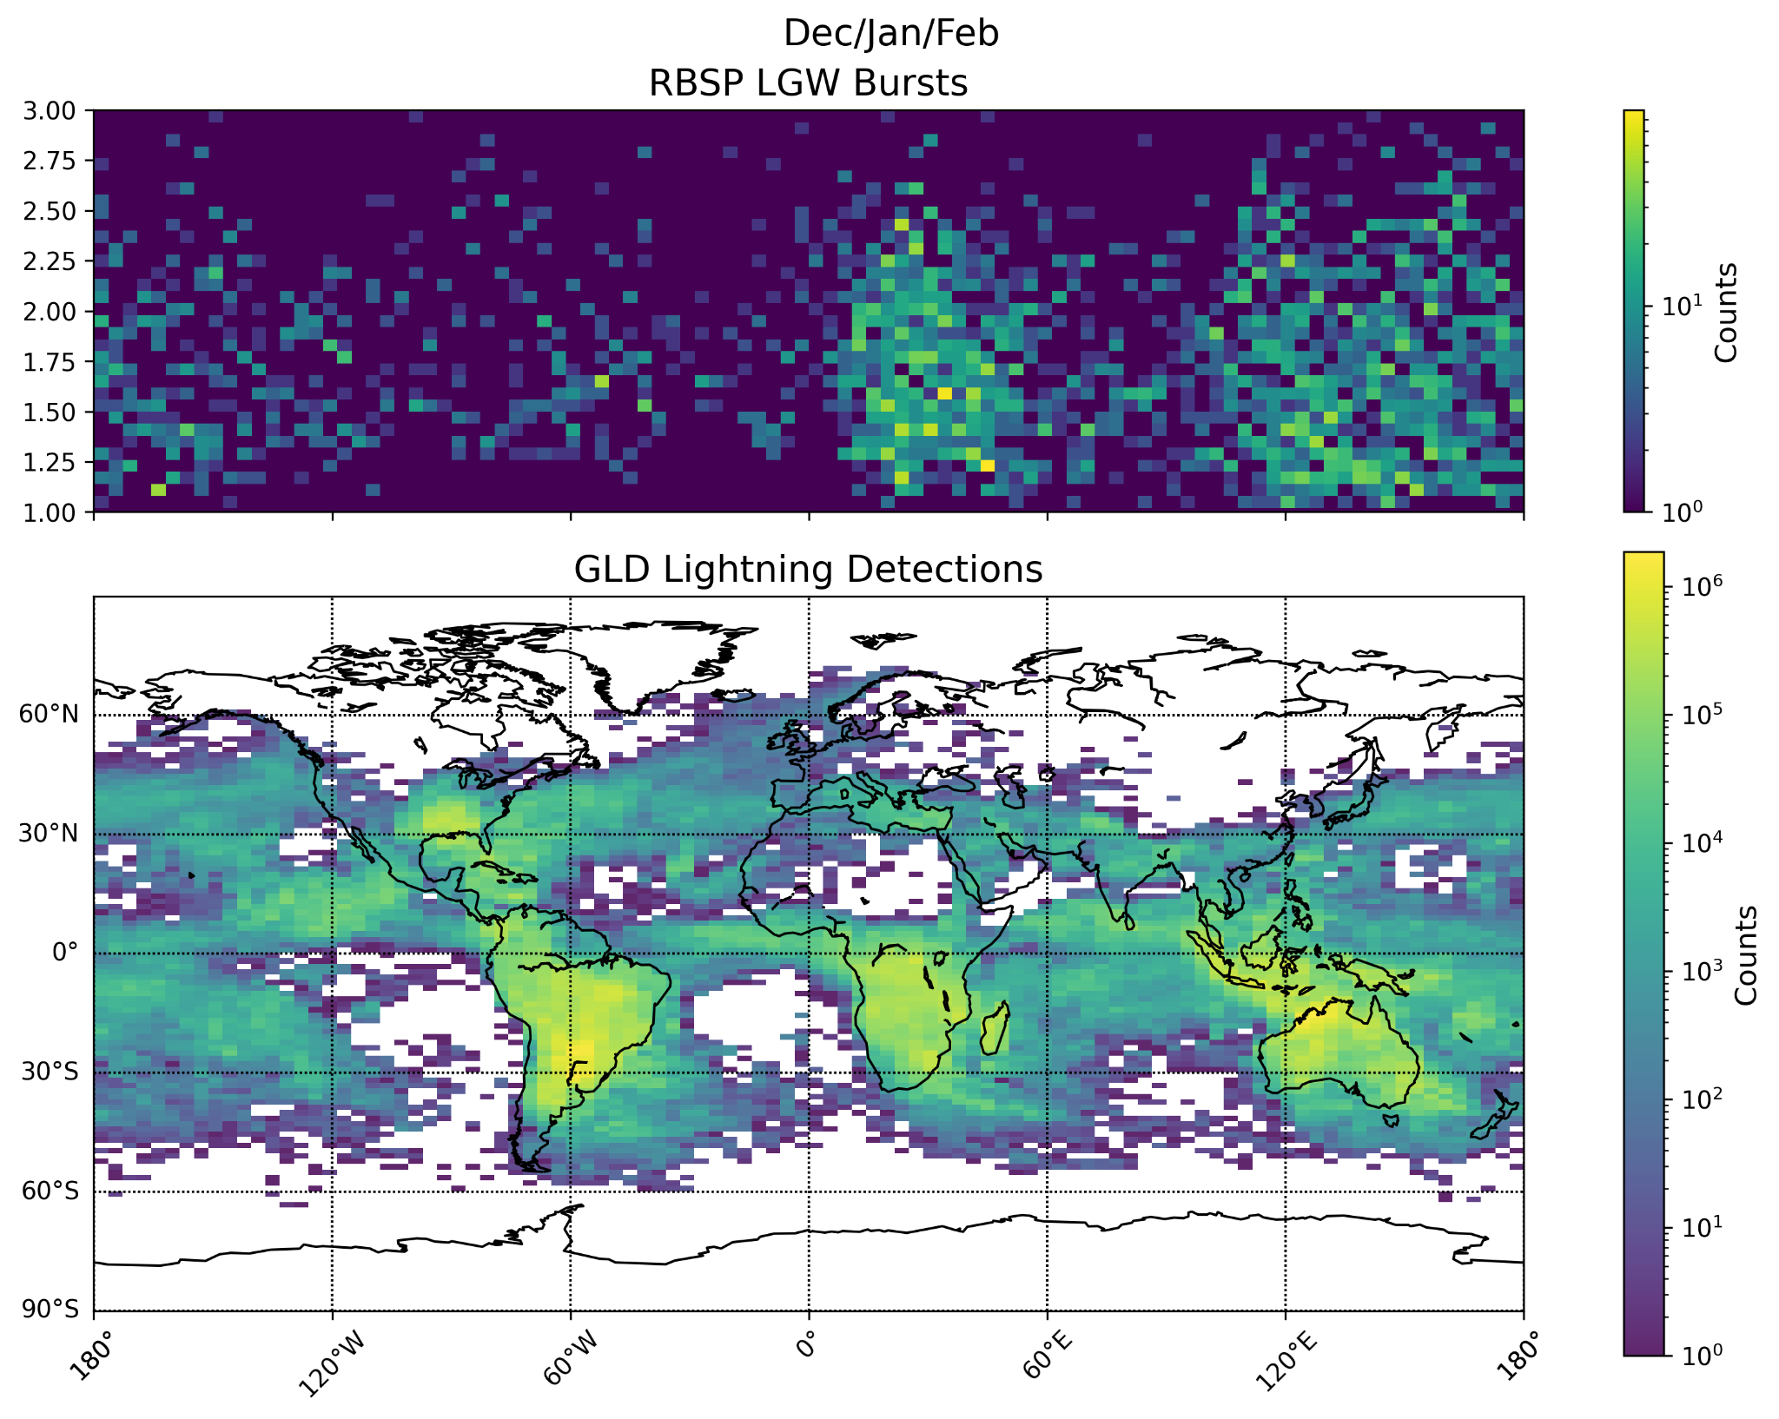
Comparison of spacecraft and ground detection data (Winter 2015)
Latitude
Longitude
Notes:
Plots split into seasons,
Earth radii is the y-axis, spacecraft not orbiting above so first figure doesn’t show as much data in certain region

Slide 17
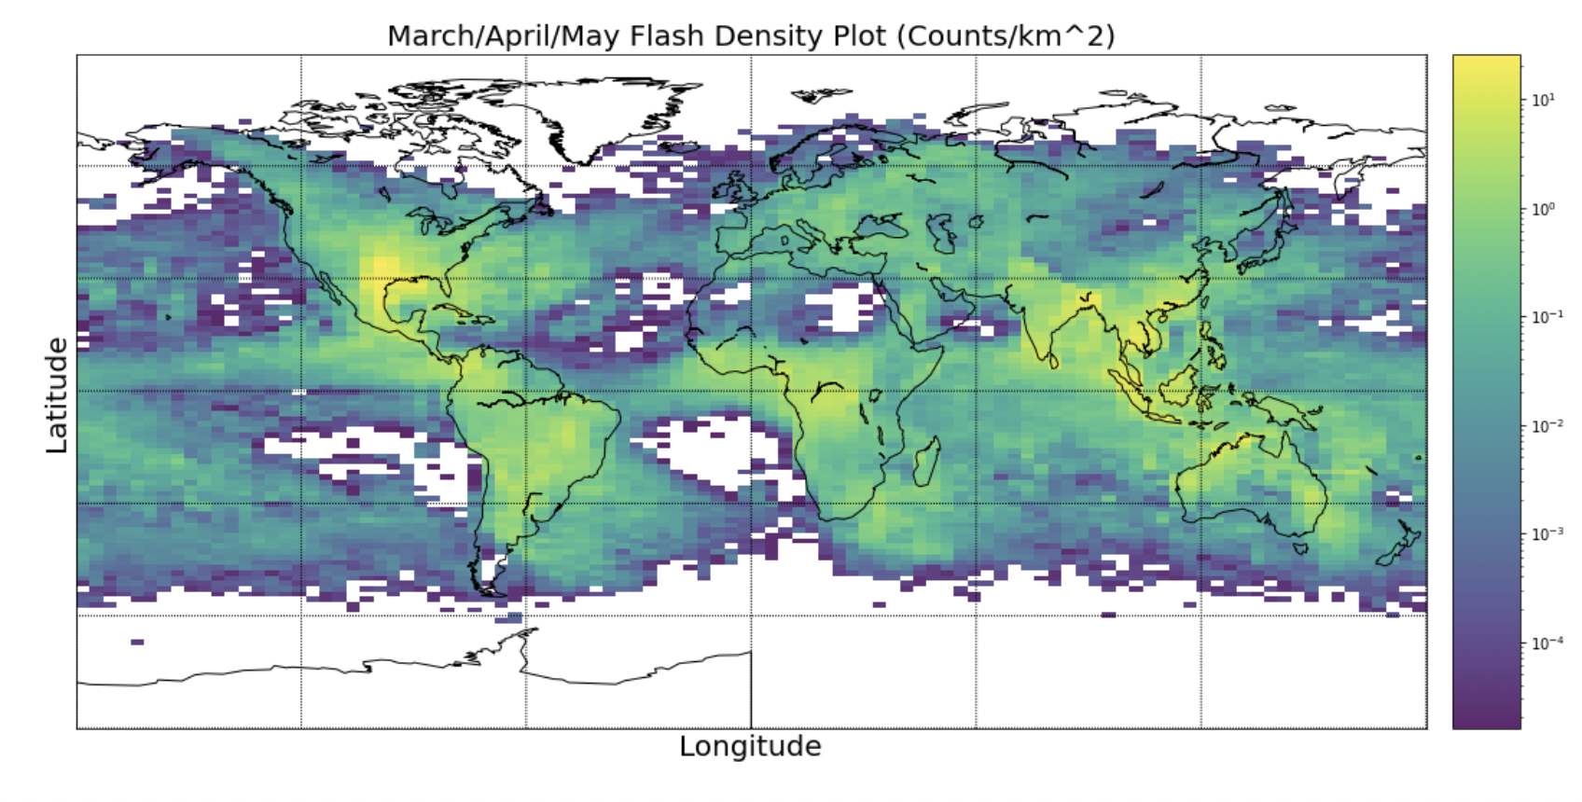
Density Plot (Spring 2015)
counts/km^2

Slide 18
Future Work

Slide 19
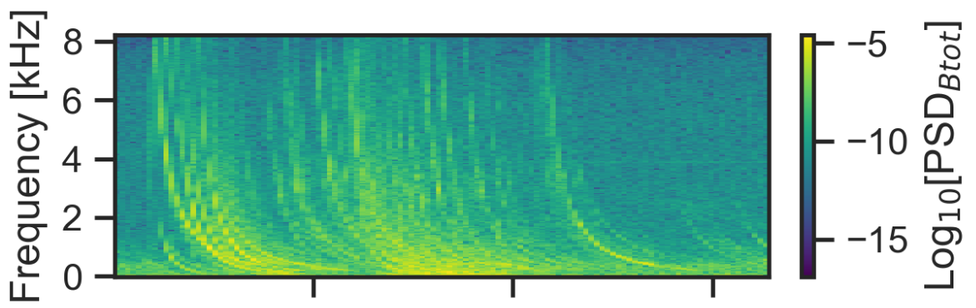
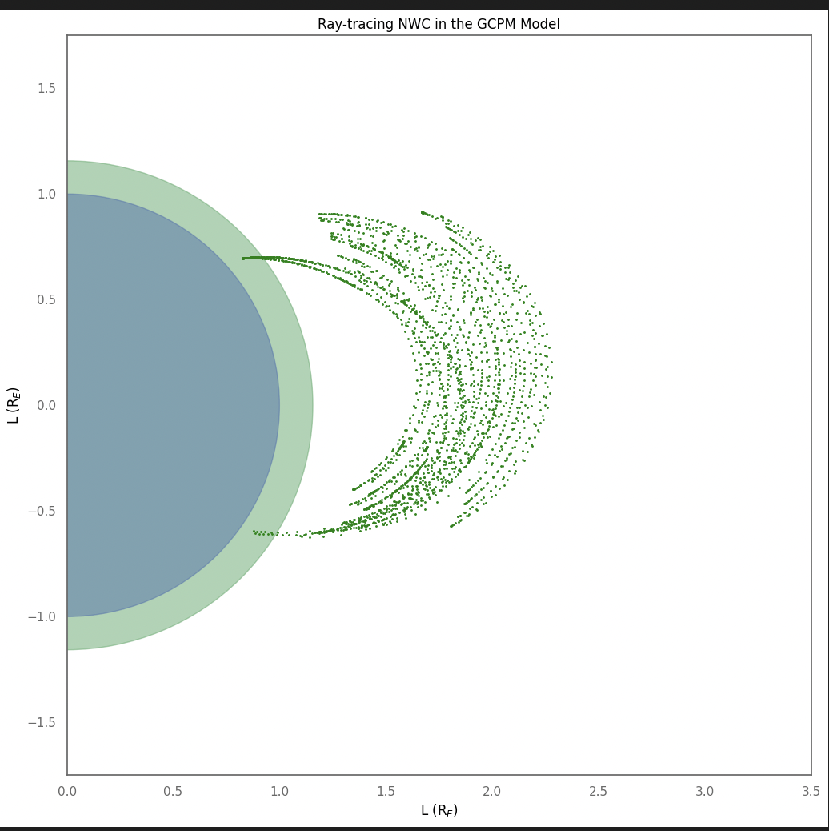

Mapping events to ray tracing outputs
Ray-tracing: method to approximate behavior of waves generated by LGW’s
Next steps:
Create database of rays
Interpolate to get estimate the wave path and the amount of lightning energy that makes it to space from the ground
Comparing estimate with actual measured amplitude of LGW from the Van Allen Probes to understand how well model actually works
RBSP LGW measurement
GLD lightning detection
Notes:
We know the peak current of the lightning on the ground from GLD
We know the wave amplitude of the LGW in space from RBSP
Models of ionospheric attenuation combined with landau damping in the ray tracer estimate the amount of the lightning’s energy that makes it to space from the ground.
Steps to compute average energy:
Ray-Tracing
Landau Damping: estimate amount of lightning’s energy that makes it to space
Interpolation
Integrate energy density over field line and duration
(A. Sousa)
Comparing that estimate to the actual measured amplitude in space will help us understand how well our models work!

Slide 20
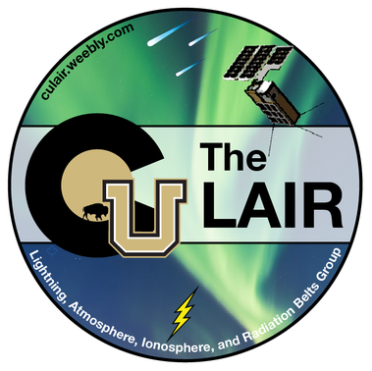

Acknowledgements
SPUR program advisor: Sharon Anderson
Grad Mentor: Alex Wold
Faculty advisor/mentor: Dr. Robert Marshall
Alex Shane
Riley Reid
Grant Berland
Austin Sousa

